Slide 1

NFL and College Football Data Analysis

Slide 2
Catalog
Introduction
Data
Analysis
Linear Regression
Clustering
Conclusion

Slide 3

Introduction
As the most popular sport in the United States, football draws numerous attention from American people. We want to find out what football game statistics have more influence on game results and predict the performance of football teams in future seasons.
Therefore, we first pick the number of predictors that has significant influence on game result using subset selection. We then compared the models suggested by best subset selection and penalized regression (LASSO). With these predictors and data from 2000 season to 2013 season, we train a linear regression model and test it with cross-validation to estimate our mean squared prediction error.
Then, we utilize PCA (principle component analysis) to reduce the dimension of our model to only two PC -values. Afterwards, we impalement K-Means clustering using the PC -values obtained above to generate 2 clusters. One cluster contains teams that have great possibility to qualify the playoffs and the other cluster contains teams that are not likely to qualify the playoffs.
We also test our clustering model on the data of 2013 season and find the result greatly fits the reality.

Slide 4
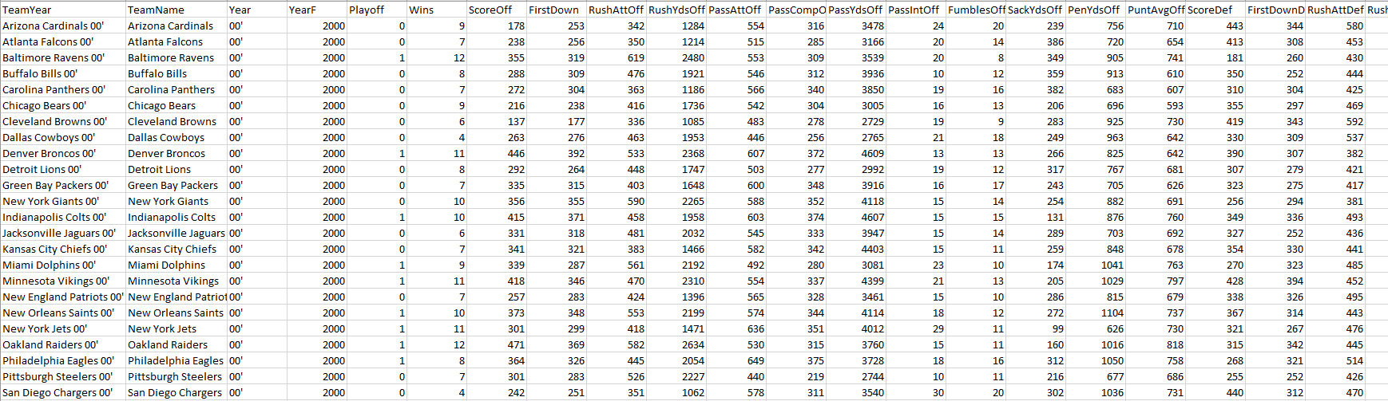
Data
Data used: NFL and College Football cumulative statistics and regular season data from 2000 to 2013
Data Processing:
For a specific team, sum up its statistics in that single season.
Put the data of every team from every season into one csv file and named it nfl_all_data and cfc_all_data. For the nfl_all_data, add another column with 1 represents that team made to the playoff that season and 0 represents the team didn’t make it and name it as nfl_playoff_all_data.
Sample data (nfl_playoff_all_data) shown below.

Slide 5
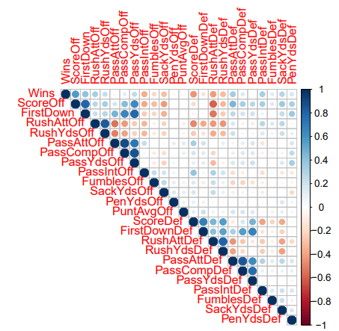
Analysis – Linear Regression

Slide 6
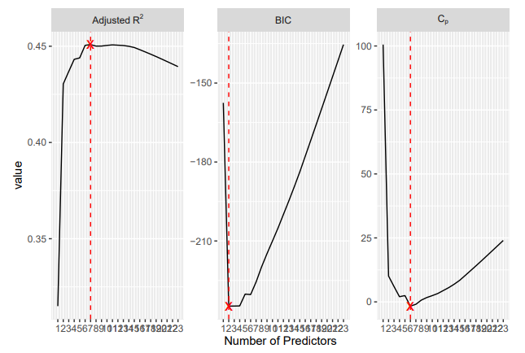
Analysis – Linear Regression

Slide 7
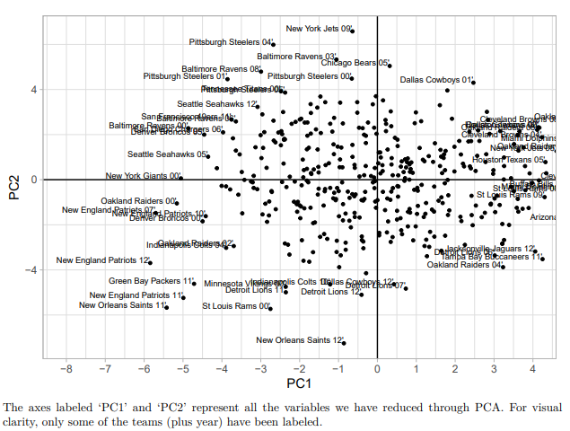
Analysis - Clustering

Slide 8
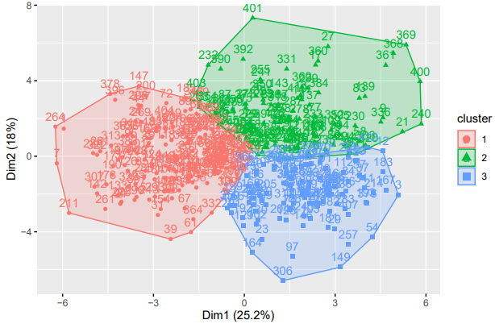
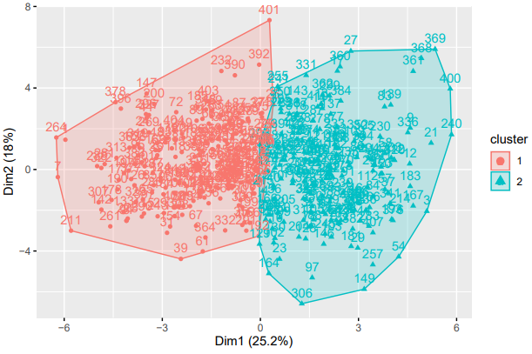
Analysis - Clustering

Slide 9
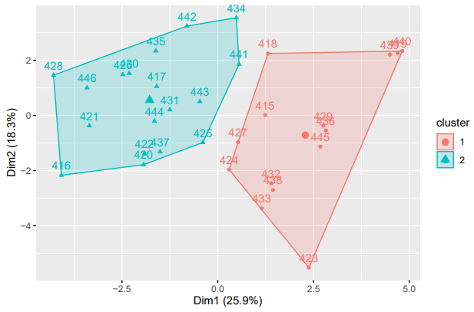
Analysis - Clustering

Slide 10
Conclusion

